Slide 1
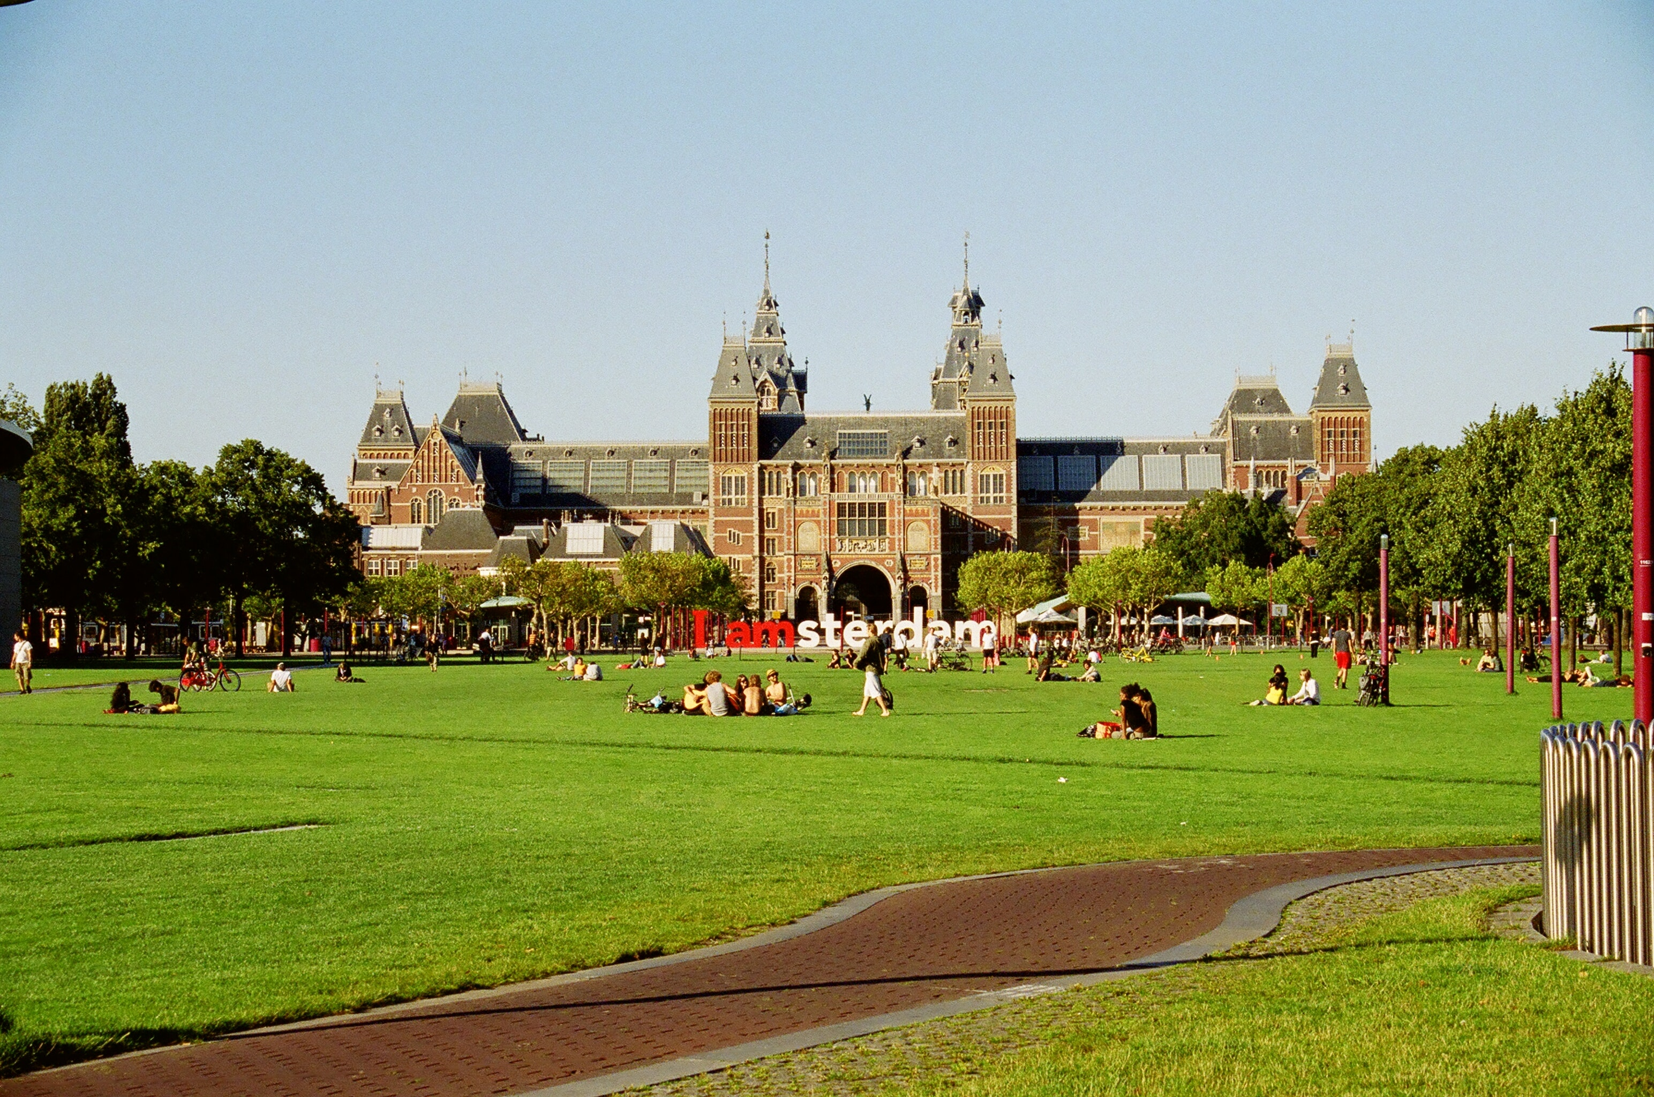
Are the people living in Amsterdam paying attention to waste less compare to the EU average based on yearly data? If the conclusion to the first question is affirmative, what are the environmental initiatives for avoiding waste in Amsterdam?

Slide 2
Area | Year | Separation percentage of total household waste [Percentage] | Total household waste presented [Kilos per inhabitant]
Amsterdam | 2012 | 13.00% | 433
Amsterdam | 2013 | 16.00% | 423
Amsterdam | 2014 | 17.00% | 427
Amsterdam | 2015 | 19.00% | 399

Slide 3
Waste category | 2014 | 2015 | 2016 | 2017 | 2018
household residual waste | 287.1 | 278.8 | 256.3 | 250.1 | 244
bulky household waste | 56.3 | 38.8 | 66.2 | 63.9 | 68.8
renovation residual waste | 9.3 | 5.4 | 5.1 | 5.3 | 6
biodegradable waste | 0.7 | 0.5 | 0.5 | 0.7 | 0.5
wastepaper and cardboard | 27.1 | 26.6 | 22.5 | 21.3 | 20.7
packaging glass | 21 | 18.5 | 17.8 | 17.5 | 18
textile | 2.8 | 3.1 | 3.4 | 3.5 | 3.6
small toxic waste | 0.5 | 0.6 | 0.6 | 0.3 | 0.3
plastic packaging / PMD fraction | 1.7 | 2 | 2.6 | 3.1 | 3.5
discarded electrical and electronic appliances | 1.9 | 1.8 | 1.6 | 1.5 | 1.4
bulky garden waste | 2.7 | 3.5 | 4.3 | 1.6 | 1.5
metal | 0.8 | 0.8 | 0.8 | 0.8 | 0.9
wood waste (A and B wood) | 9.1 | 11.8 | 13.1 | 4.9 | 6.1
clean debris | 3.8 | 3.5 | 2.9 | 3.4 | 3.2
other waste | 2.1 | 3.1 | 0.9 | 2.8 | 2.7
Total household waste | 426.9 | 398.8 | 398.6 | 380.7 | 381

Slide 4
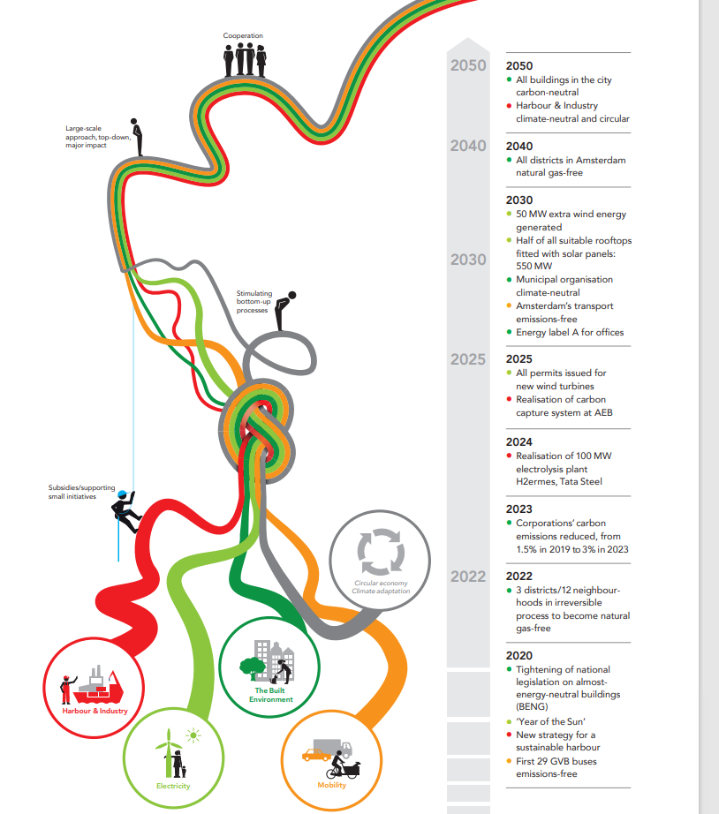
Vision of a Climate-Neutral Amsterdam in 2050

